Slide 1
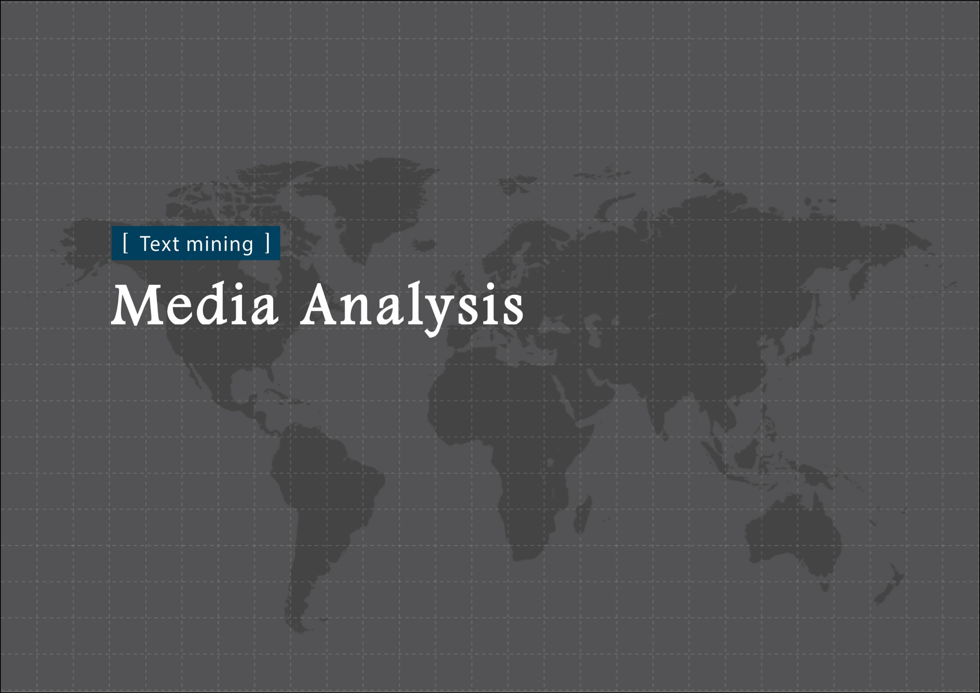

Slide 2
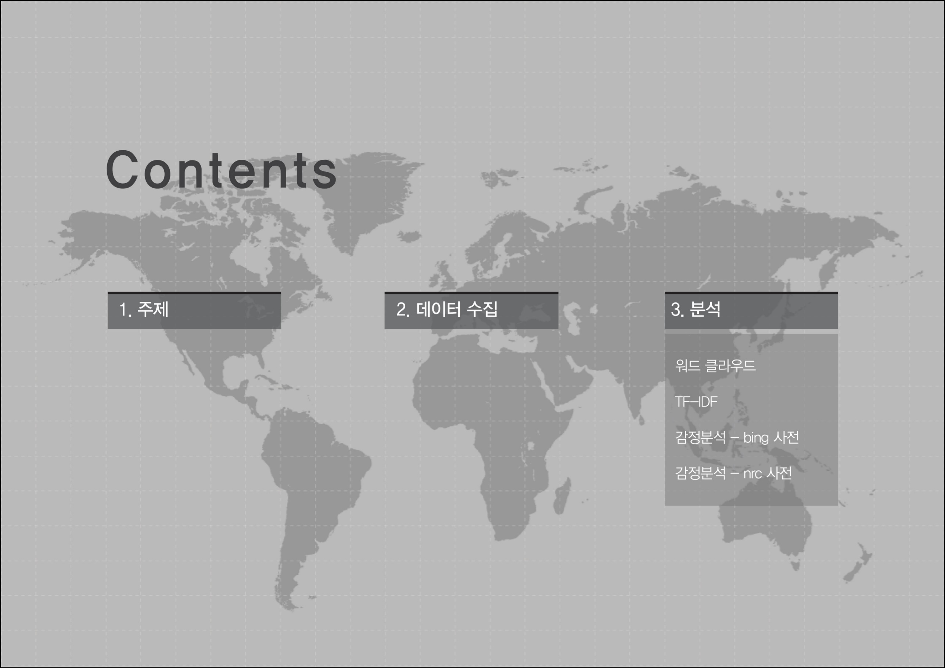

Slide 3
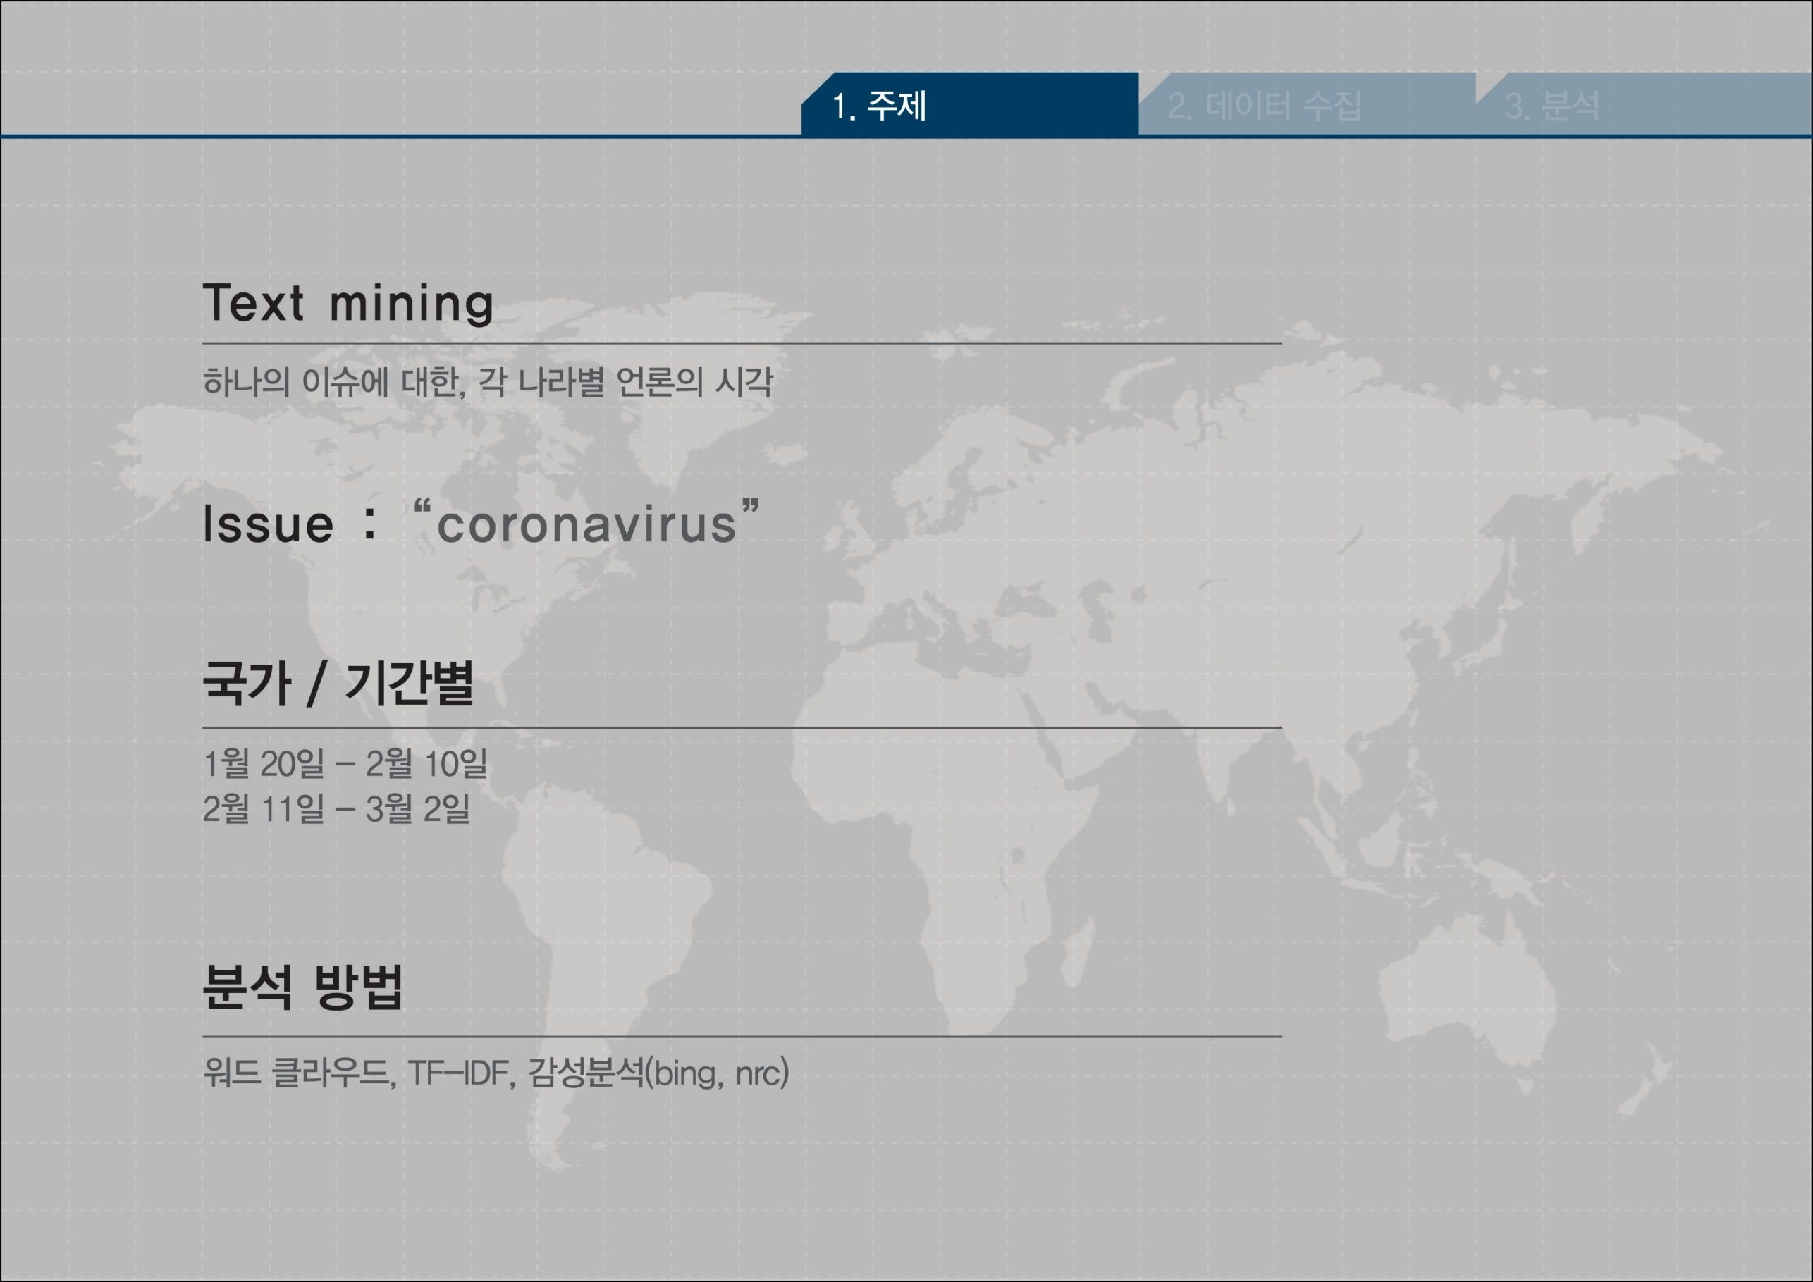

Slide 4
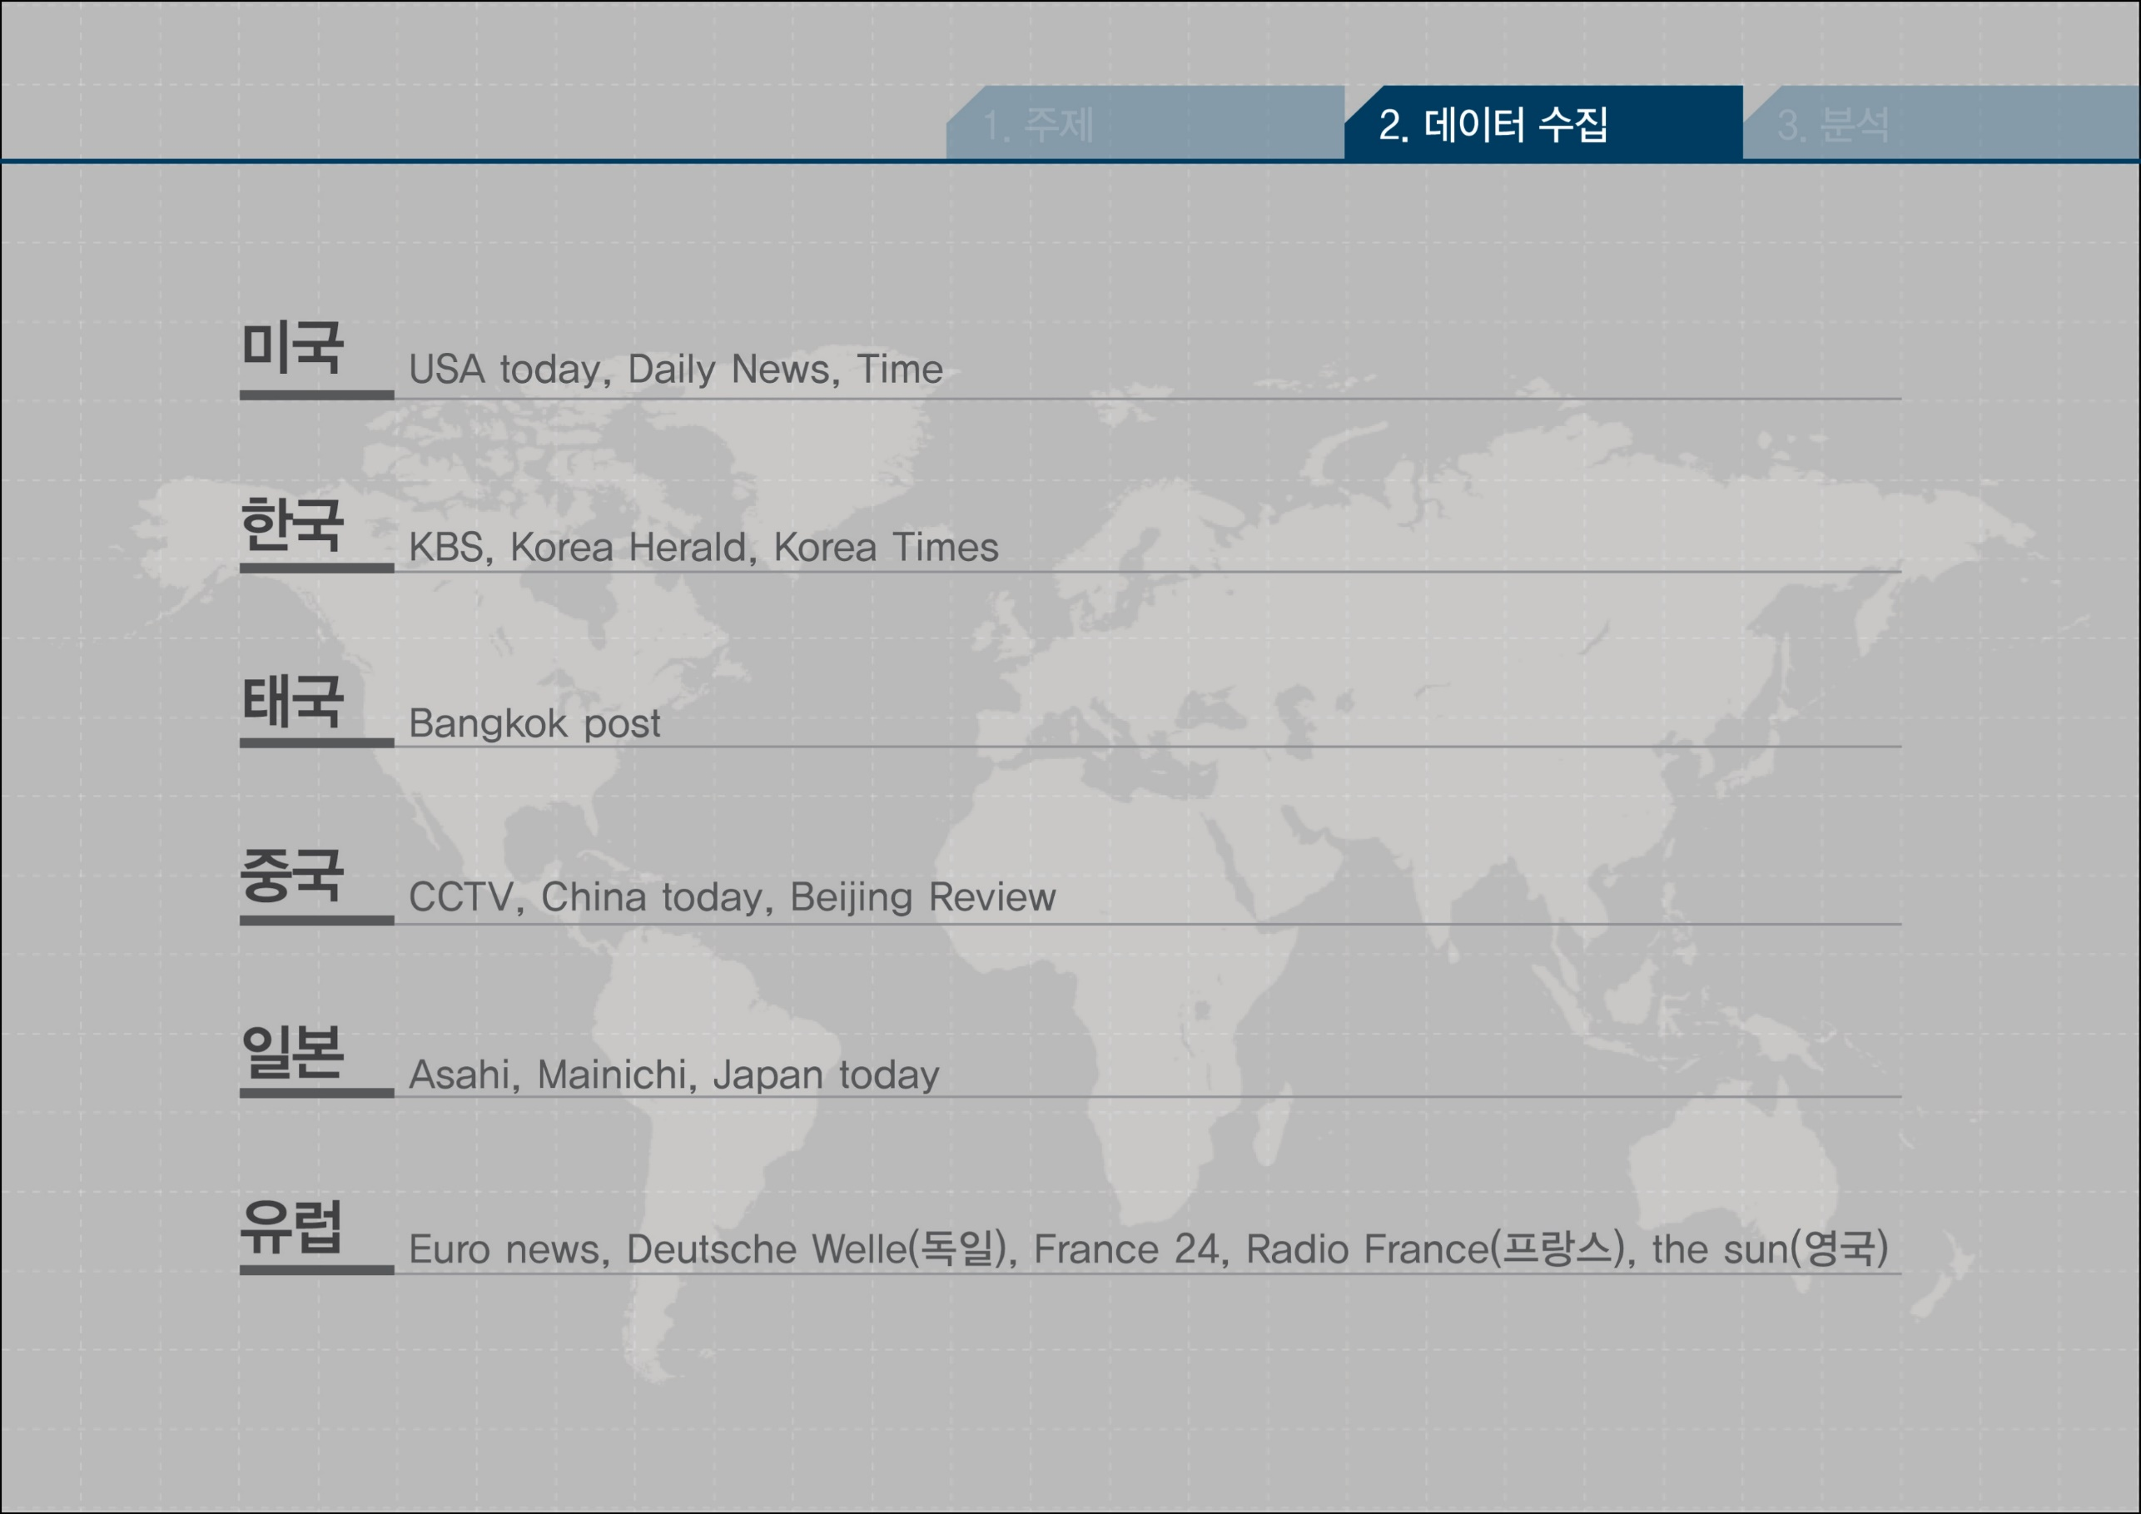

Slide 5
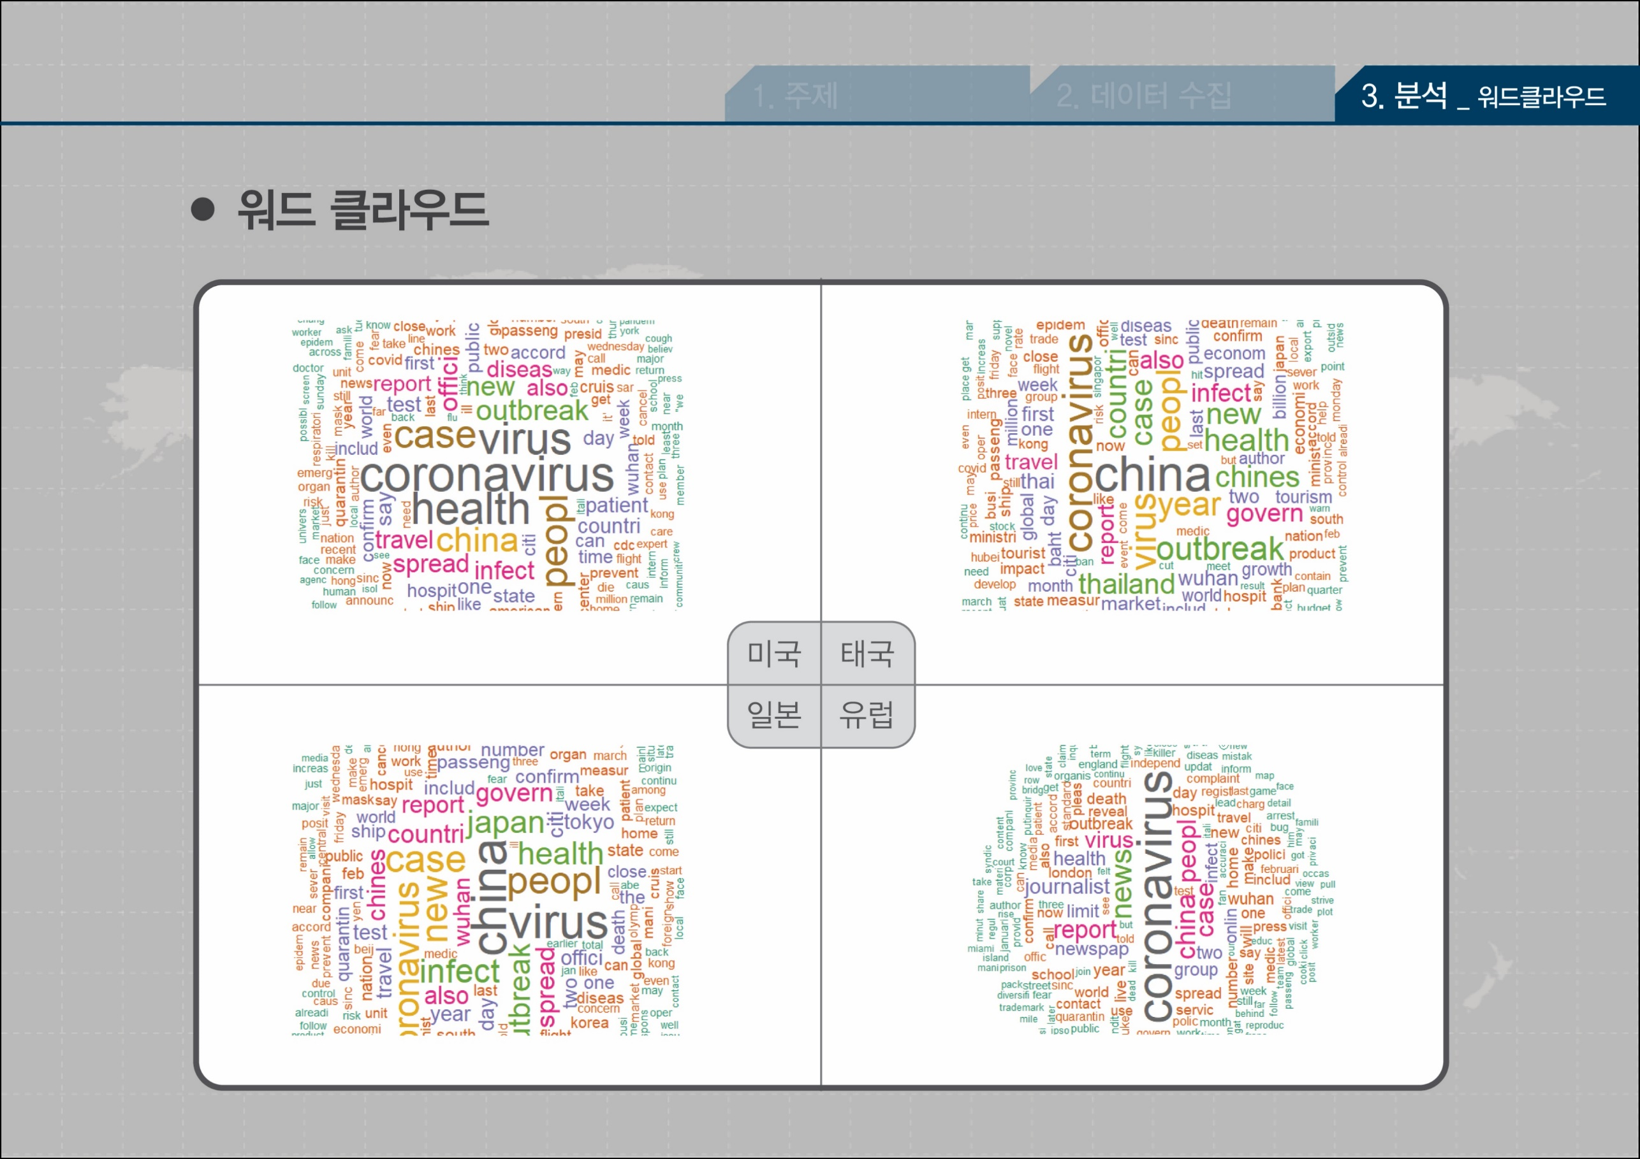
“coronavirus, virus, china” “outbreak, infect, spread”

Slide 6
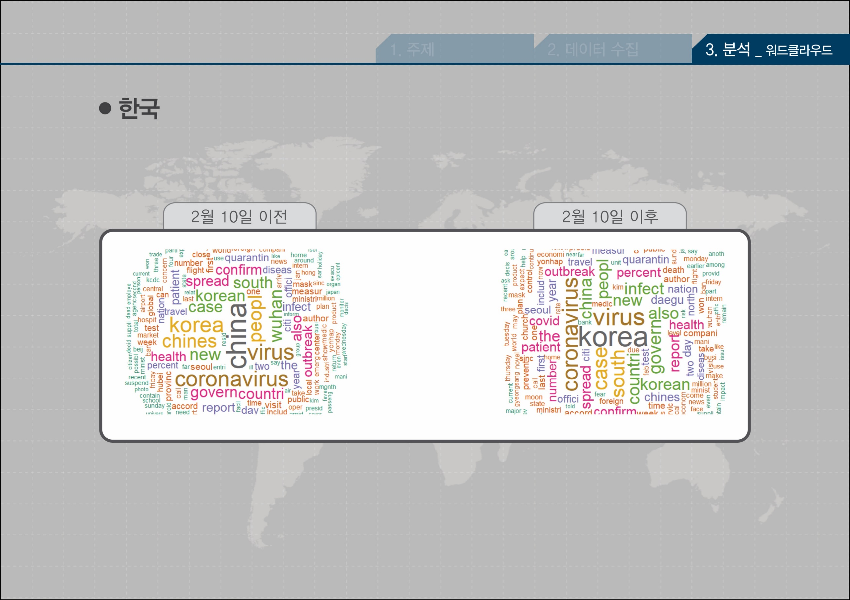
“china”
“korea”

Slide 7
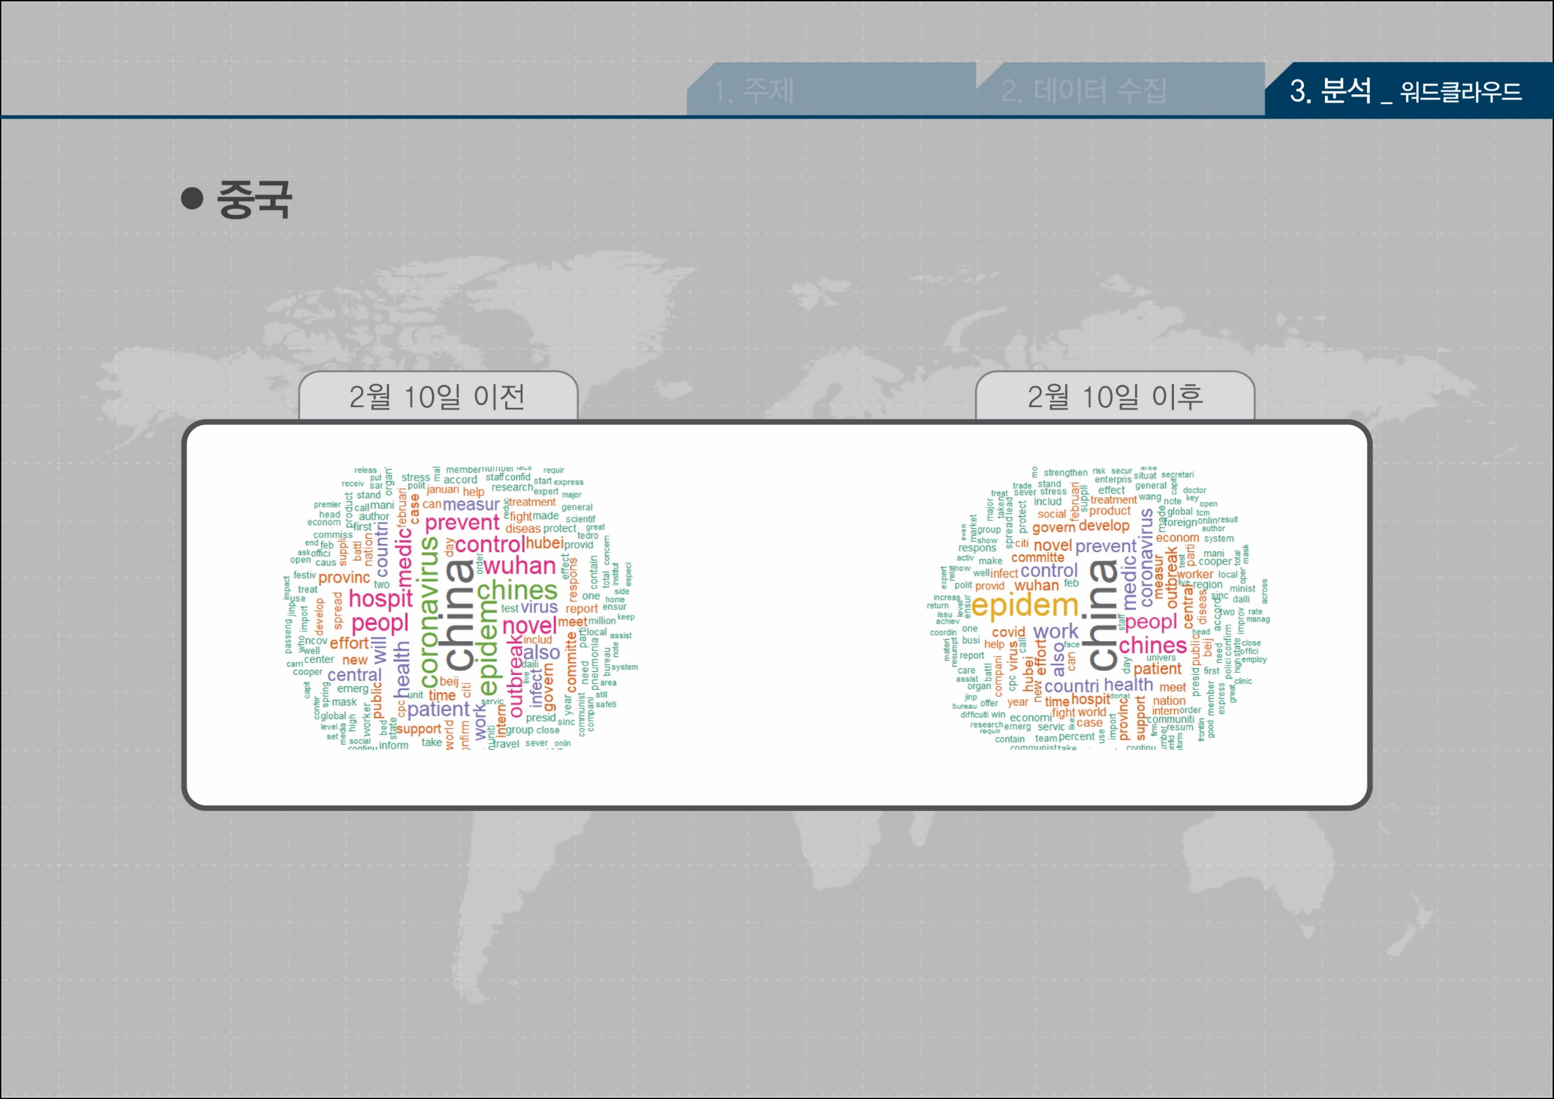
“epidemic”
“medic-”
“prevent”
“control”

Slide 8
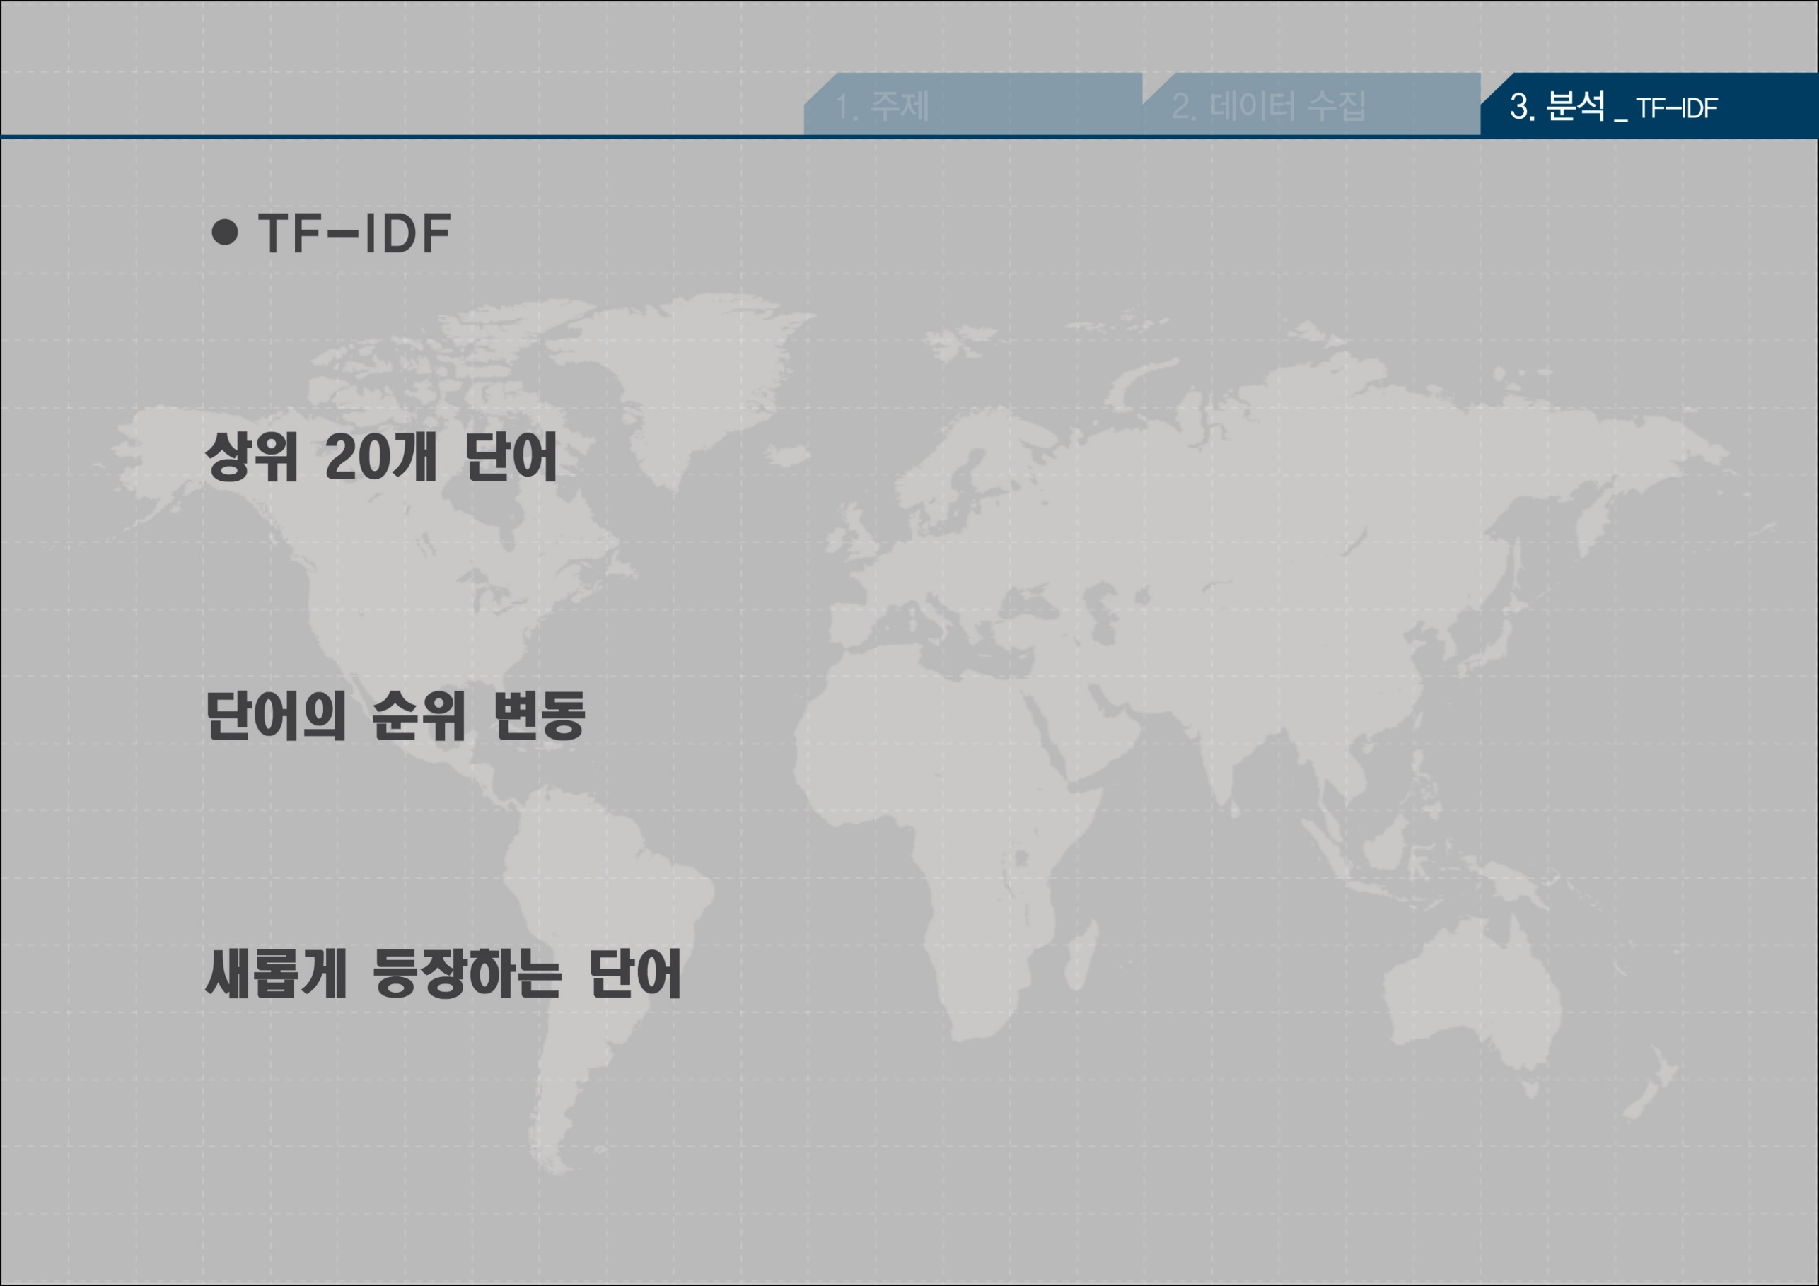

Slide 9
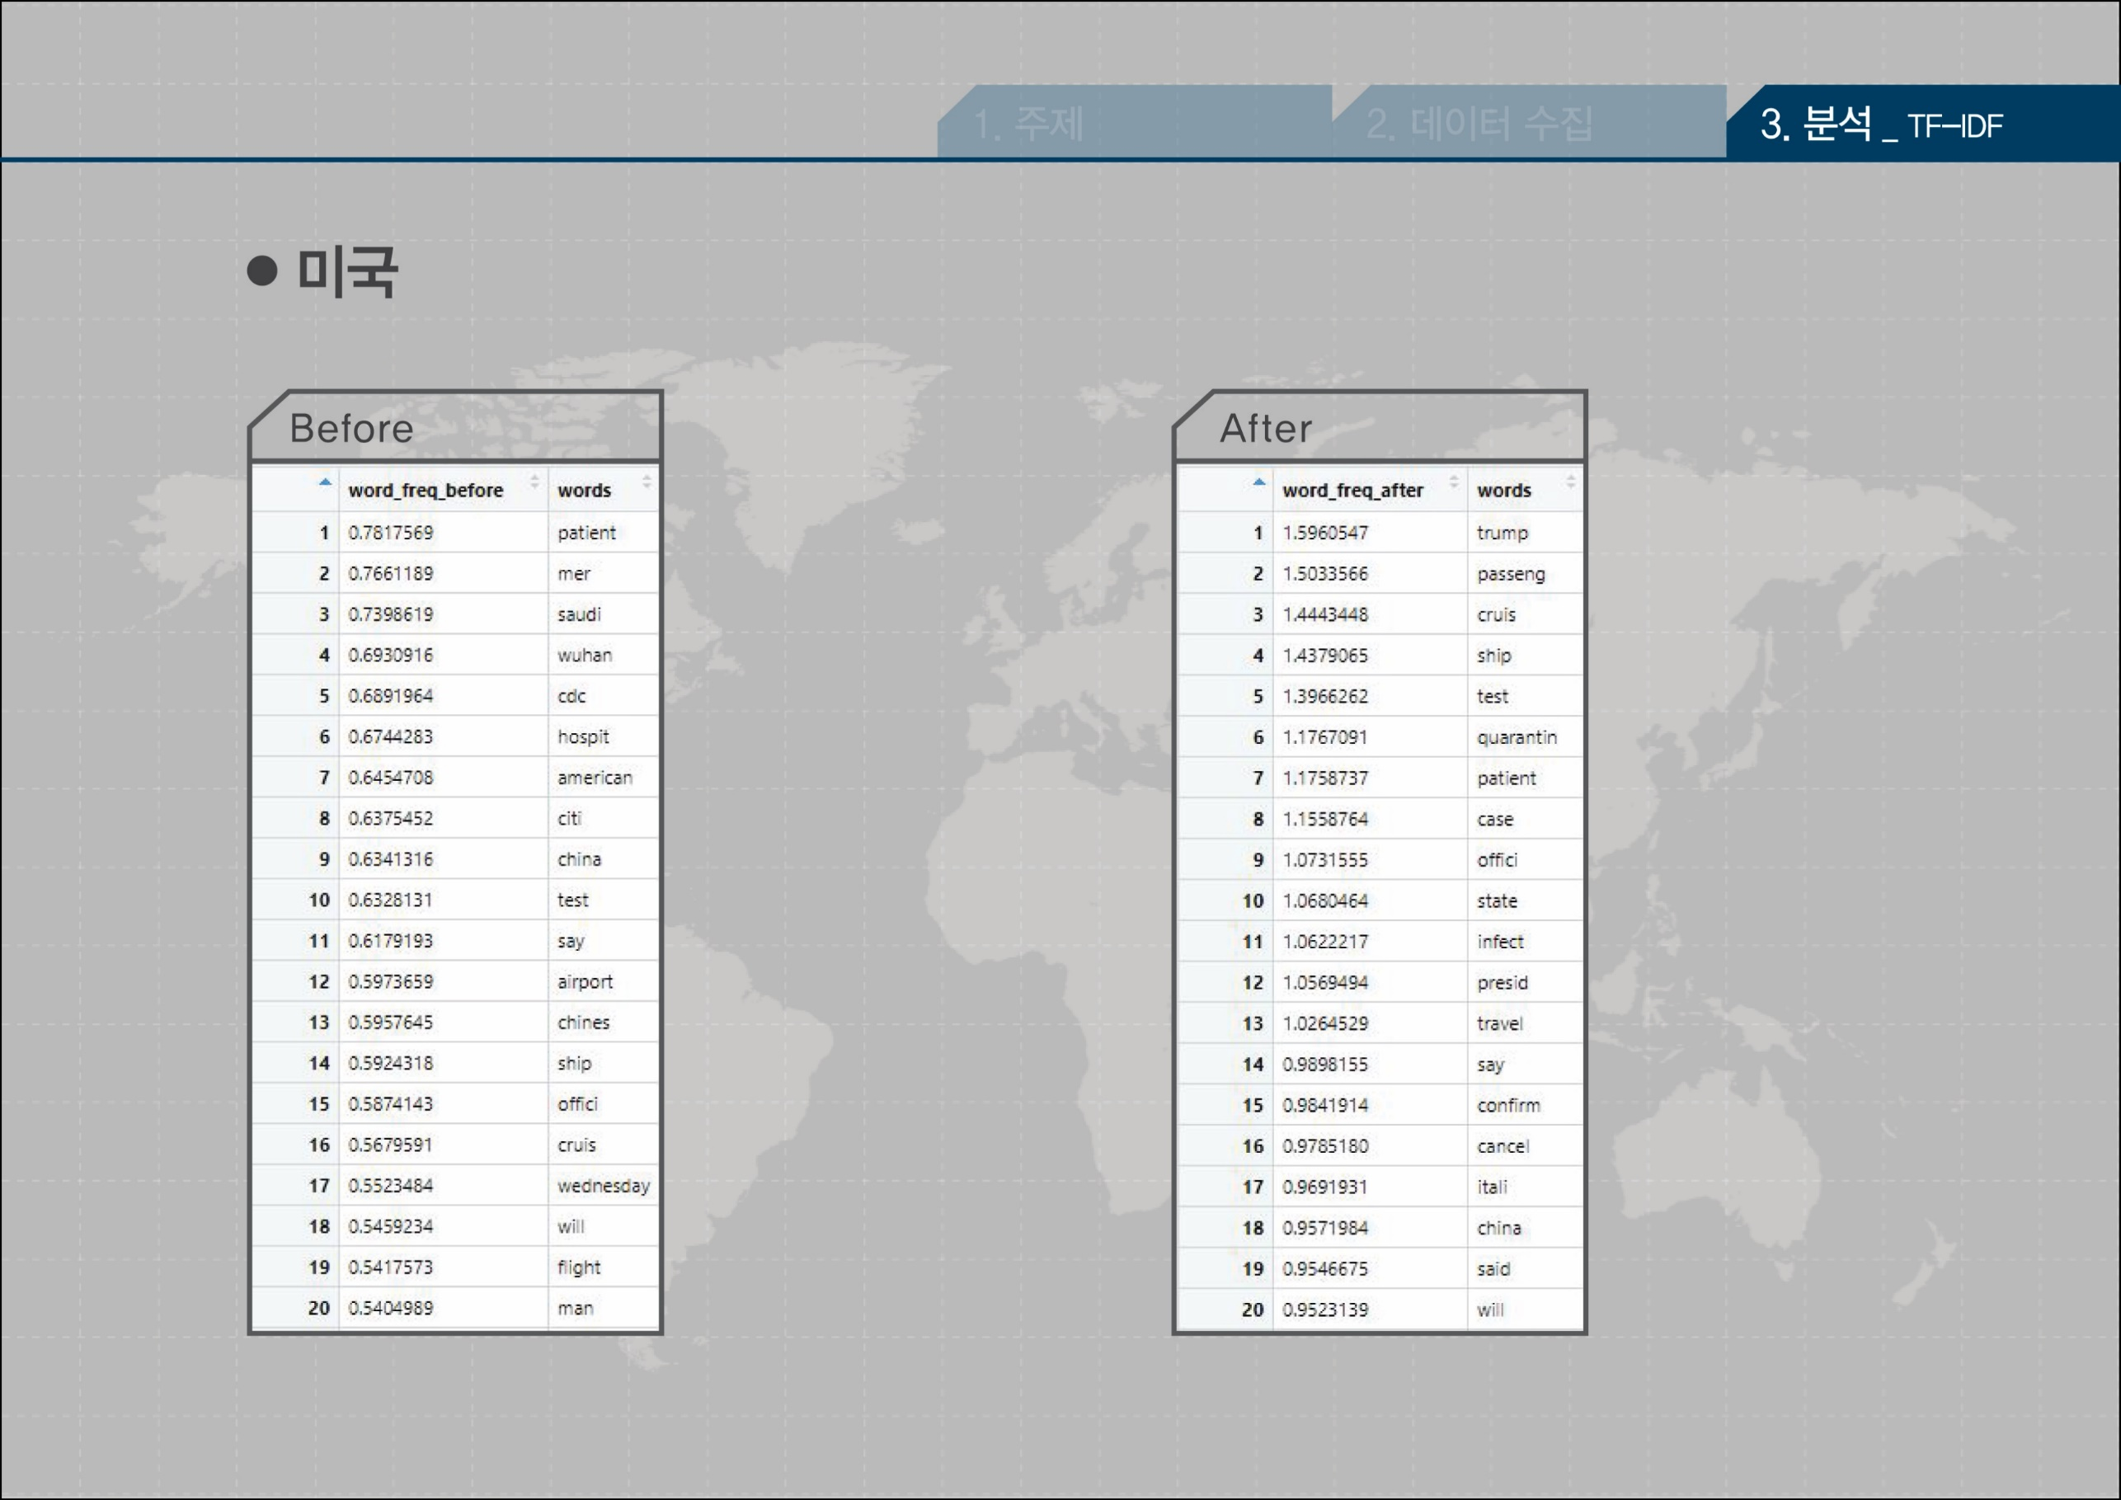
1. trump
2. passenger
3. cruise
4. wuhan
4. ship
9. china
14. ship
17. italy
18. china

Slide 10

3. daegu
5. north
11. north
12. church

Slide 11

1. baht
2. baht
4. passenger
5. ship
8. tourism
10. tourism
12. tourist
17. export
18. bank
18. travel

Slide 12

1. hospital
1. hospital
2. medic-
4. wuhan
6. wuhan
7. hubei
9. medic-
10. hubei

Slide 13

2. ship
3. passenger
6. olympics
8. ship
10. wuhan
12. passenger
13. taiwan
17. hongkong
17. south korea

Slide 14

5. ship
6. italy
7. passenger
6. virus
13. quarantine
16. cruise
20. ship

Slide 15
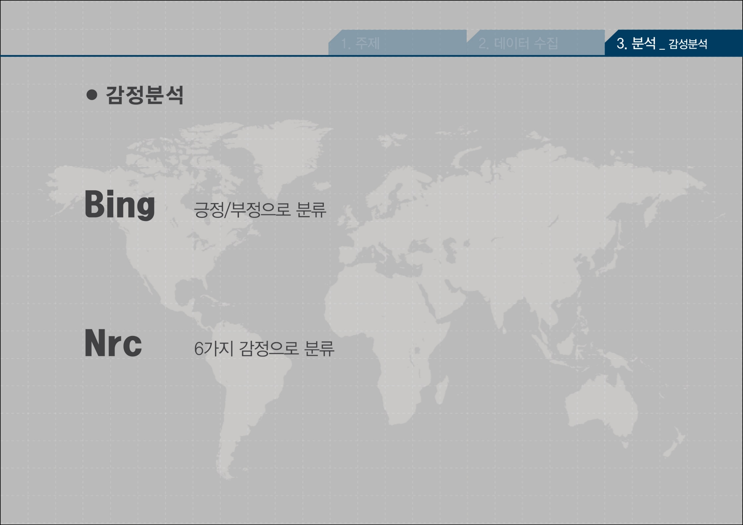
10

Slide 16
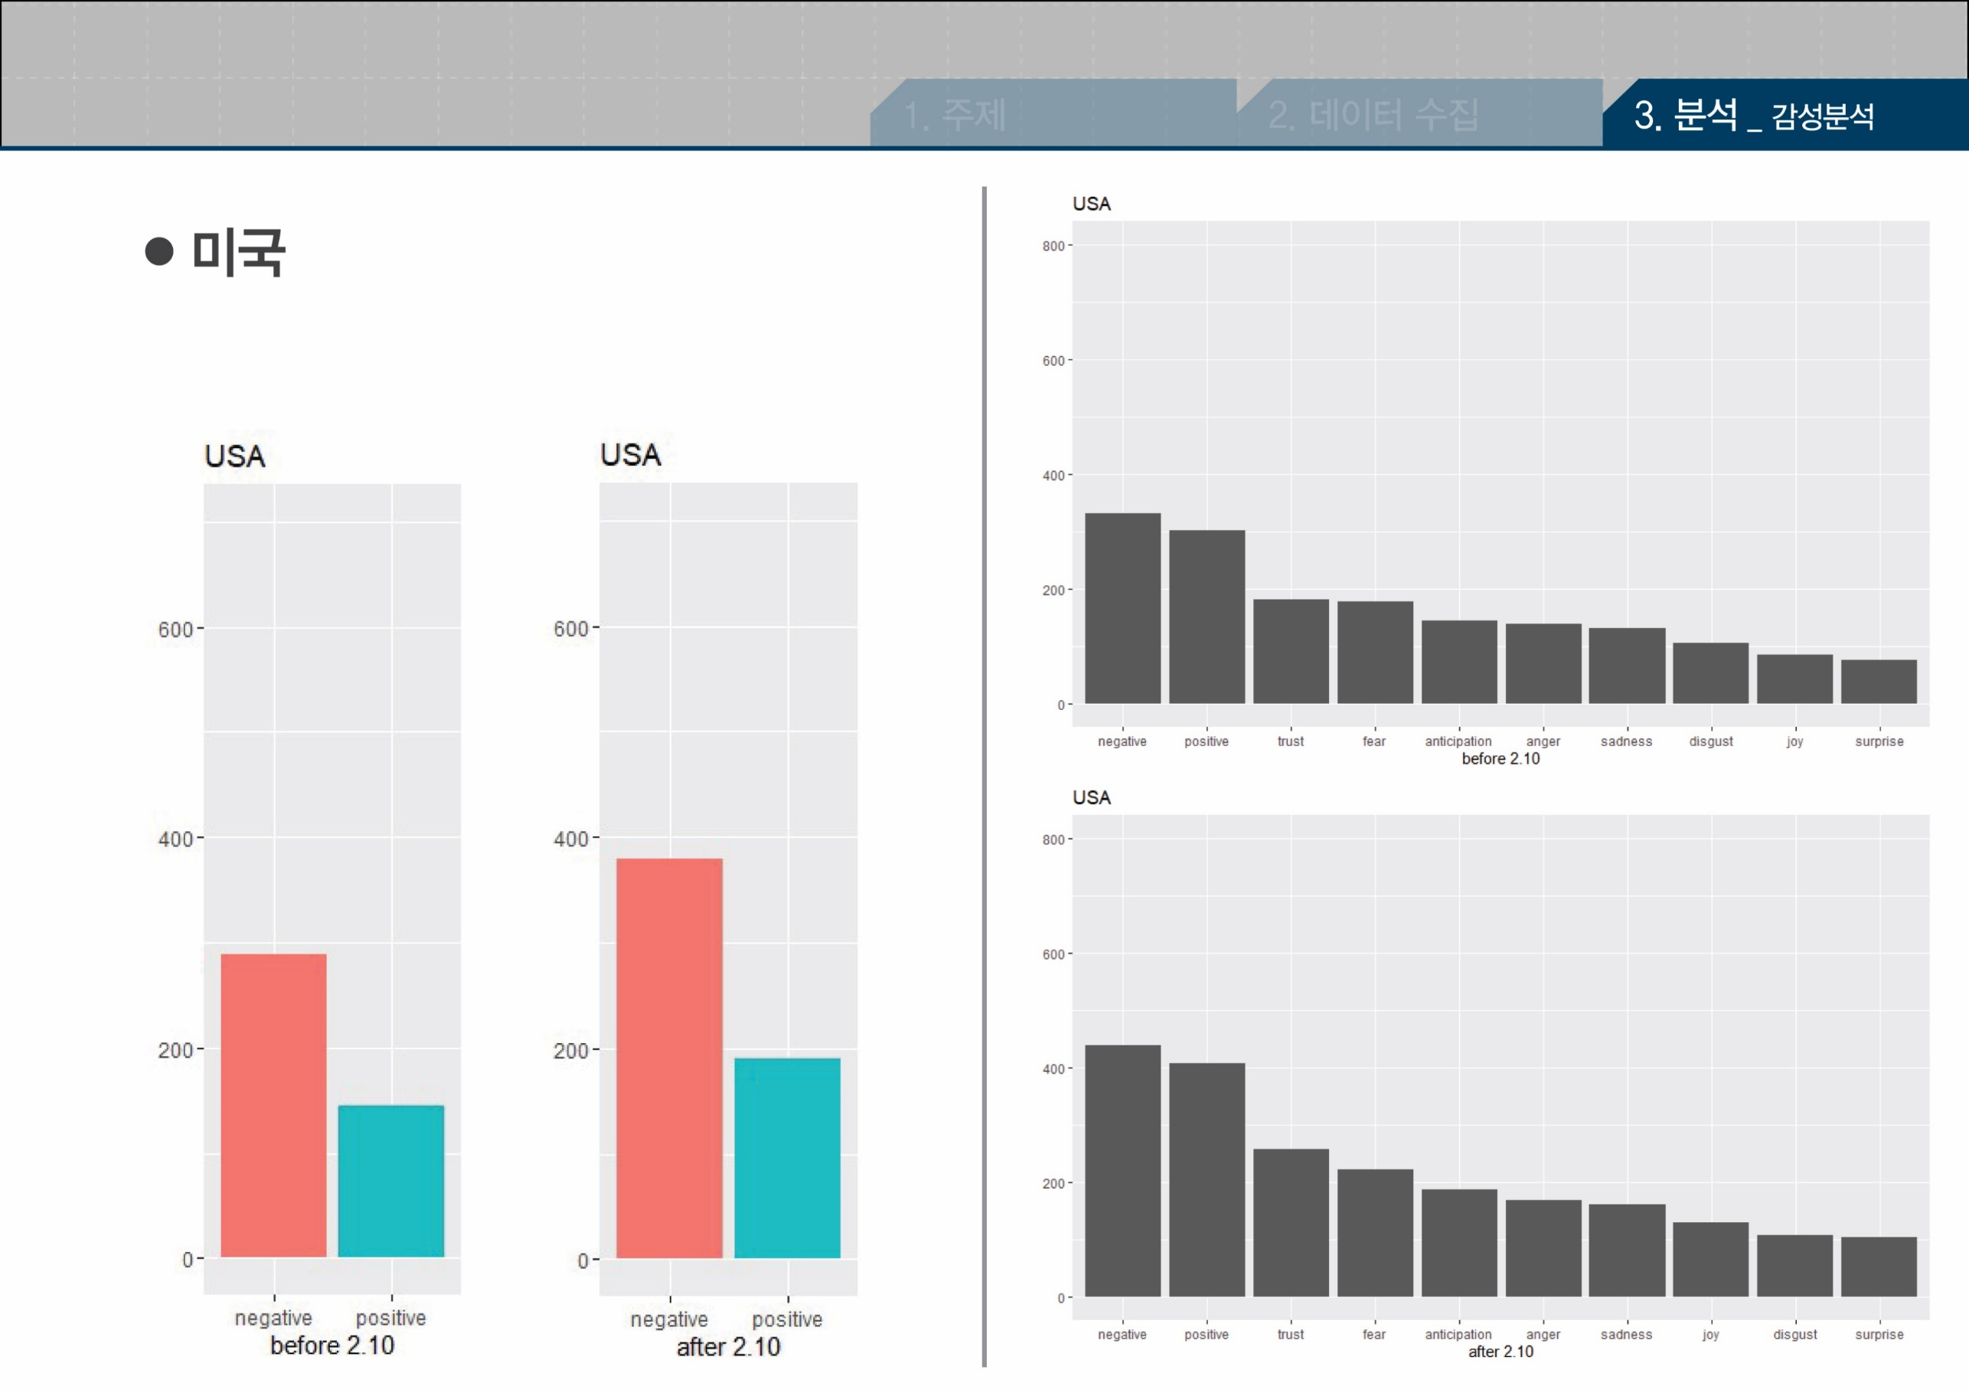
nega-tive
posit-ive
antic-ipati
-on
trust
fear
anger
sad
-ness
disgust
joy
surprise
66.60%
66.58%
nega-tive
posit-ive
trust
antic-ipati
-on
fear
sad
-ness
anger
joy
disgust
surprise

Slide 17
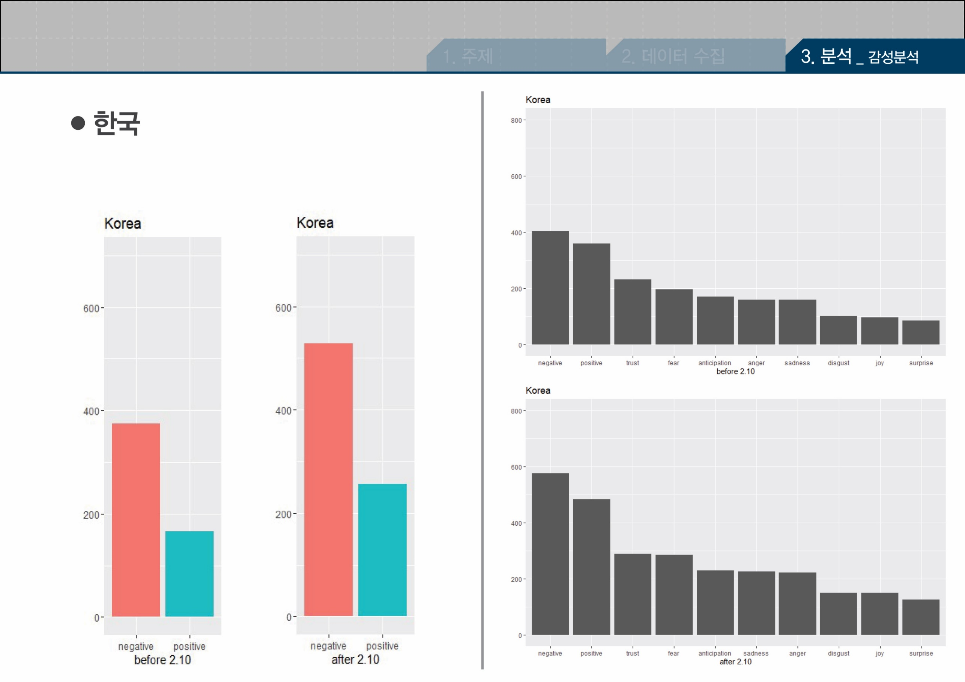
nega-tive
posit-ive
trust
antic-ipati
-on
fear
anger
sad
-ness
disgust
joy
surprise
67.26%
69.38%
nega-tive
posit-ive
trust
fear
antic-ipati
-on
sad
-ness
anger
disgust
joy
surprise

Slide 18
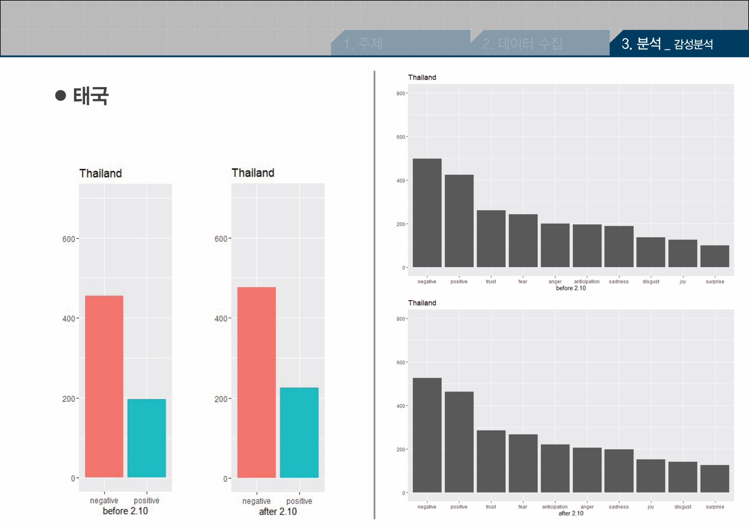
nega-tive
posit-ive
trust
antic-ipati
-on
fear
anger
sad
-ness
disgust
joy
surprise
69.89%
67.94%
nega-tive
posit-ive
trust
antic-ipati
-on
fear
sad
-ness
anger
joy
disgust
surprise

Slide 19
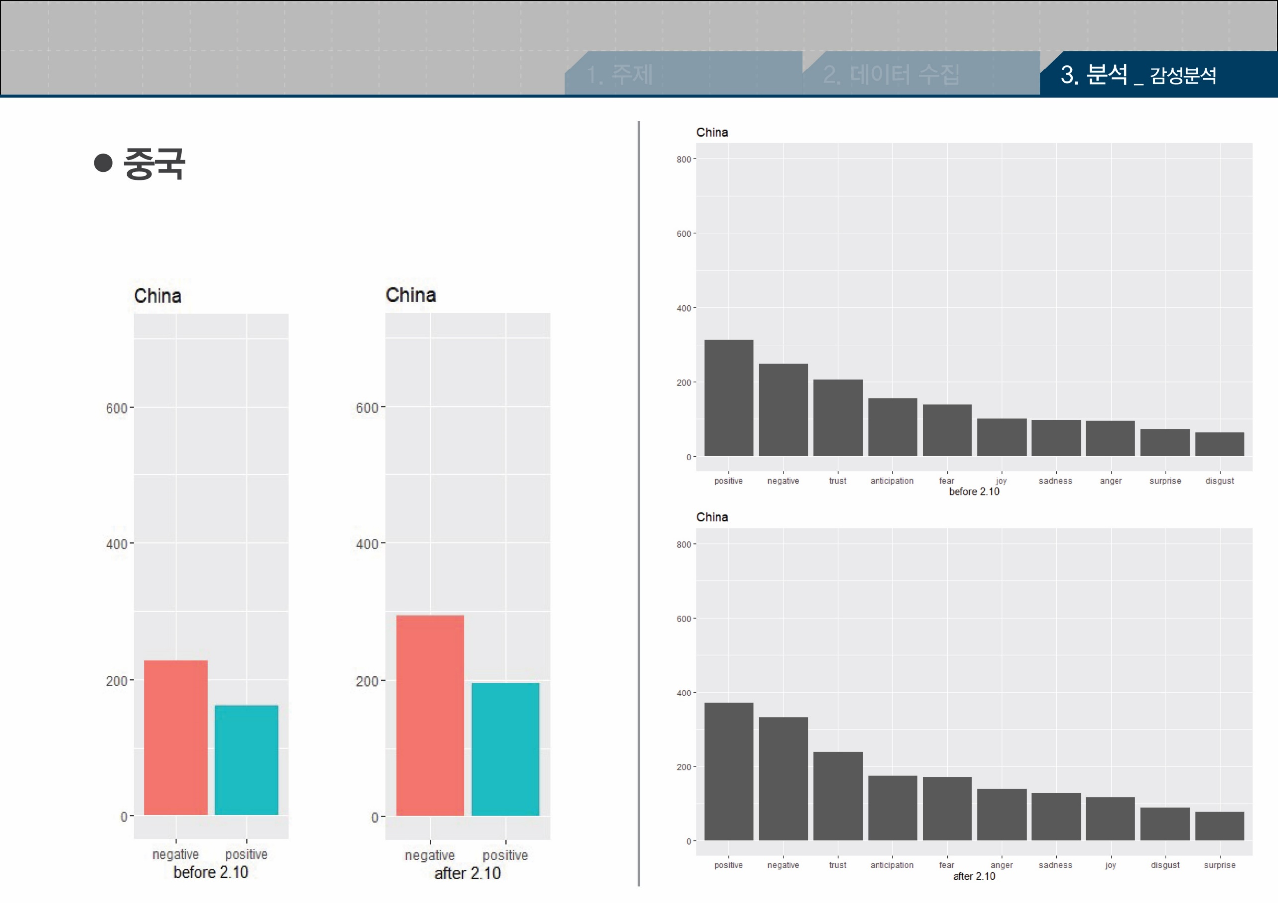
posit-ive
nega-tive
trust
antic-ipati
-on
fear
joy
sad
-ness
anger
surprise
disgust
60.04%
58.65%
posit-ive
nega-tive
trust
antic-ipati
-on
fear
anger
sad
-ness
joy
disgust
surprise

Slide 20
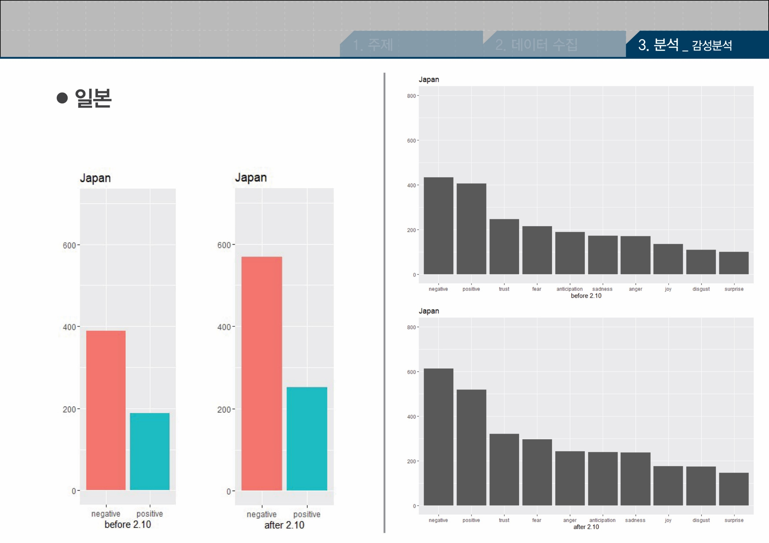
nega-tive
posit-ive
trust
antic-ipati
-on
fear
sad
-ness
anger
joy
69.39%
disgust
surprise
67.41%
nega-tive
posit-ive
trust
fear
antic-ipati
-on
anger
sad
-ness
joy
disgust
surprise

Slide 21
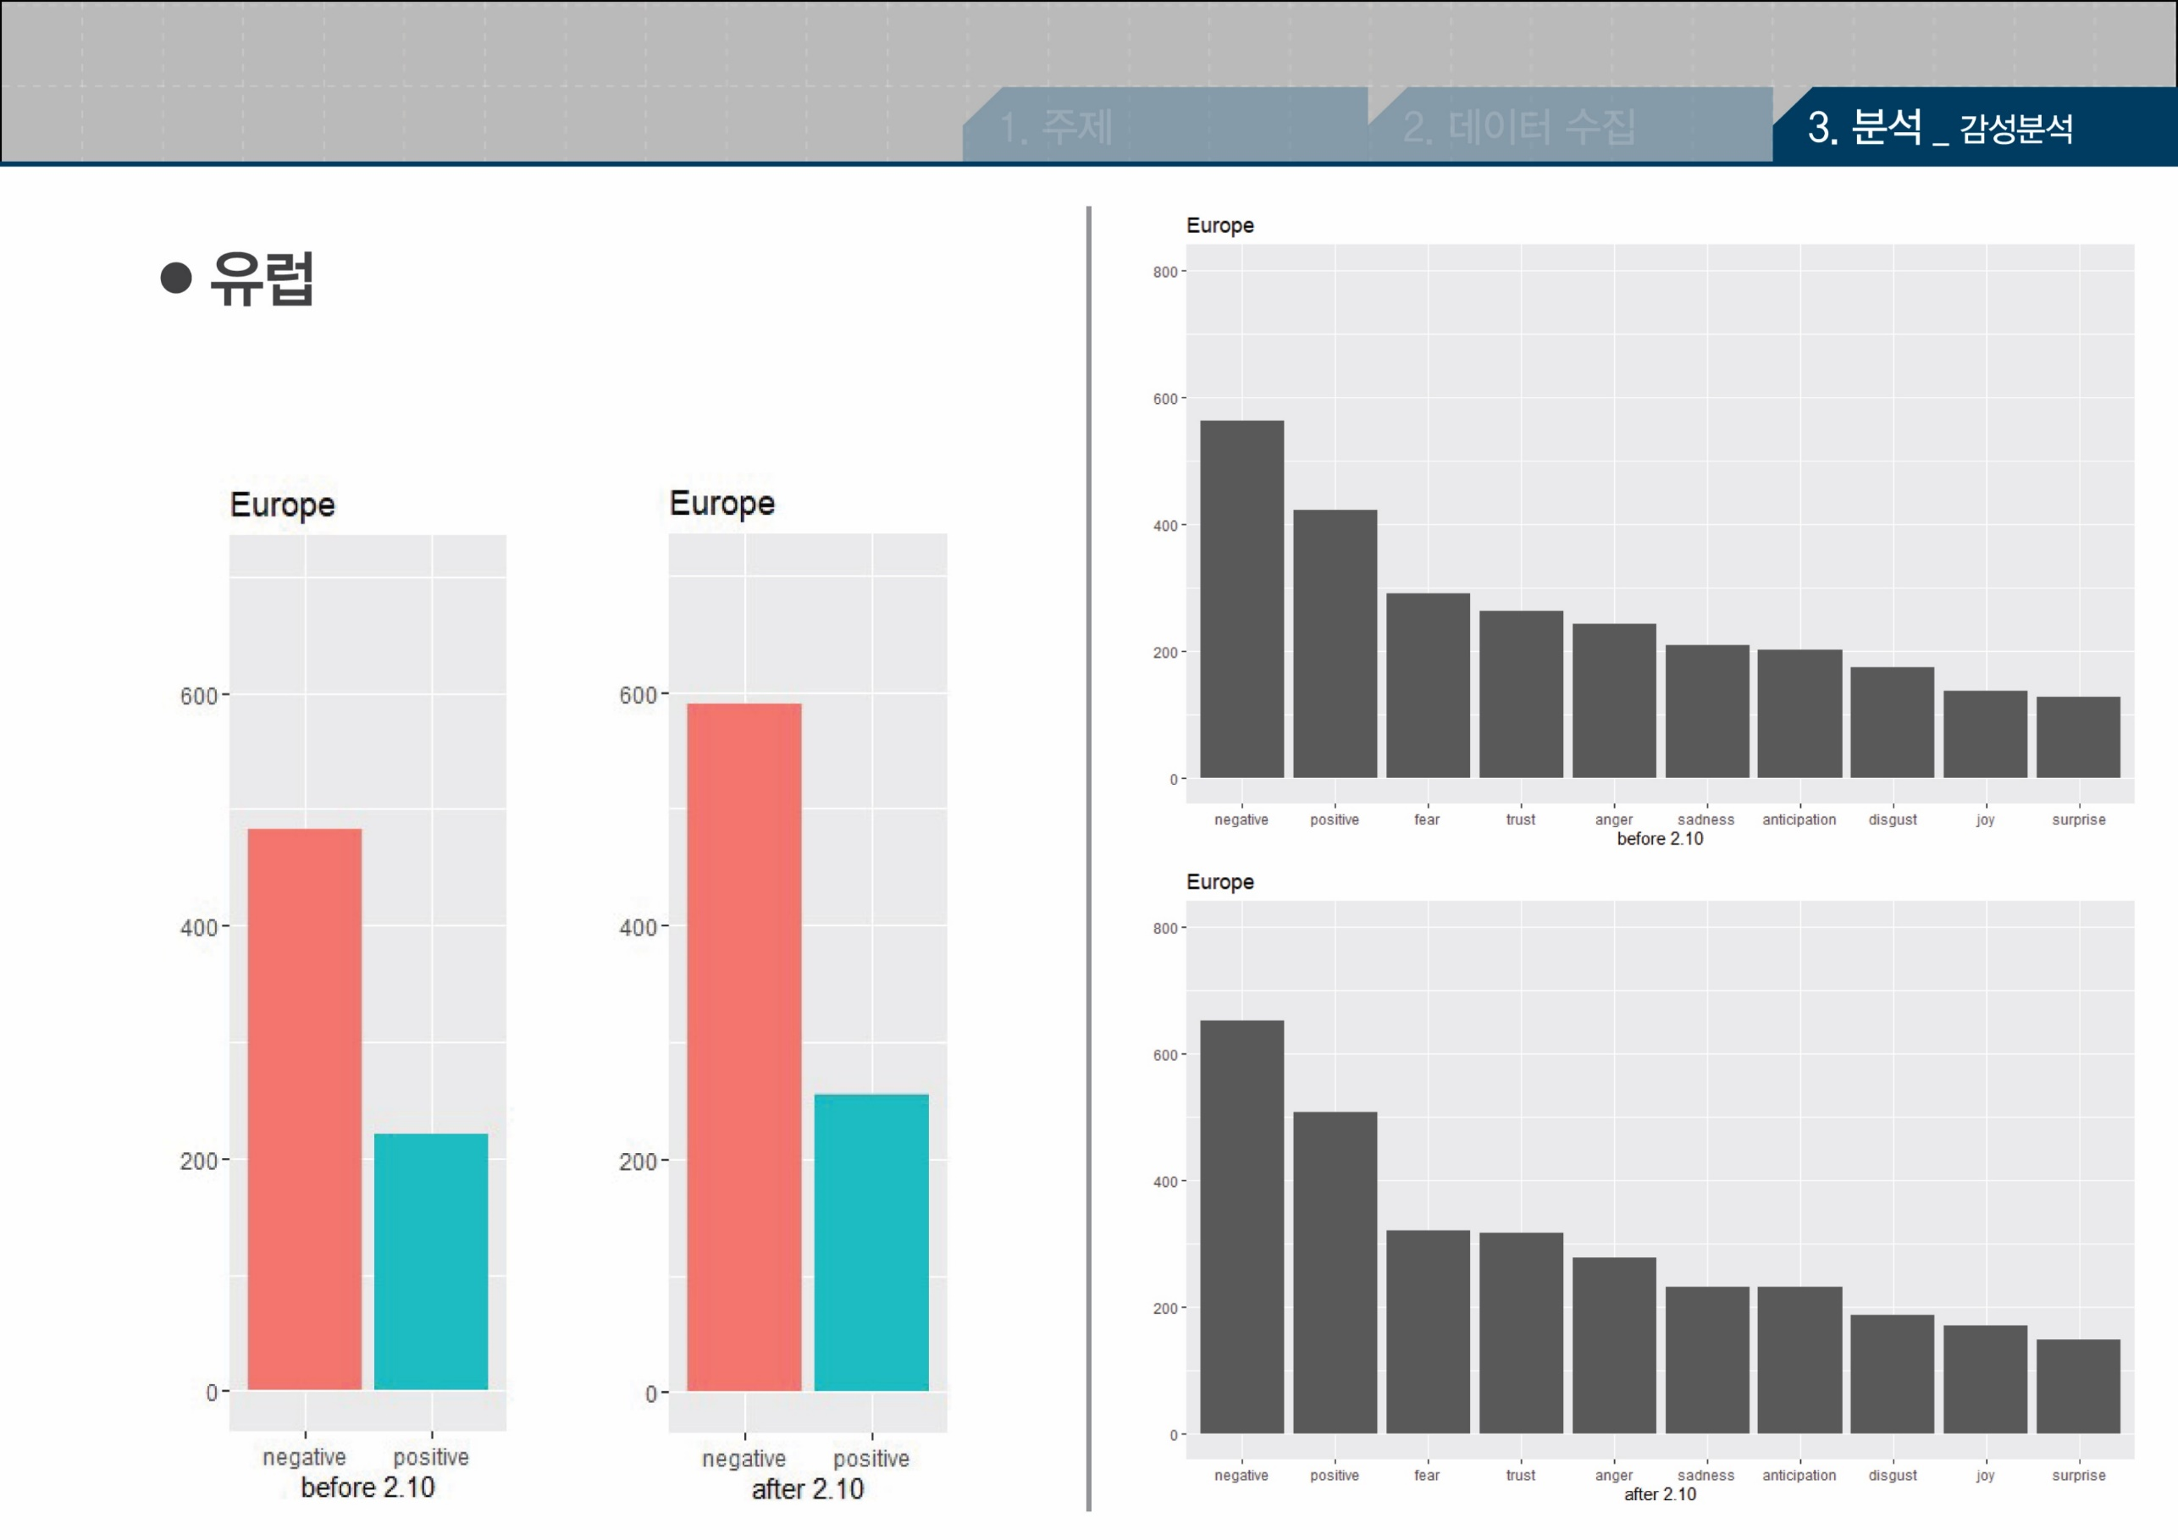
nega-tive
posit-ive
fear
trust
sad
-ness
antic-ipati
-on
anger
69.82%
disgust
joy
surprise
68.70%
nega-tive
posit-ive
fear
trust
anger
sad
-ness
antic-ipati
-on
disgust
joy
surprise

